Slide 1
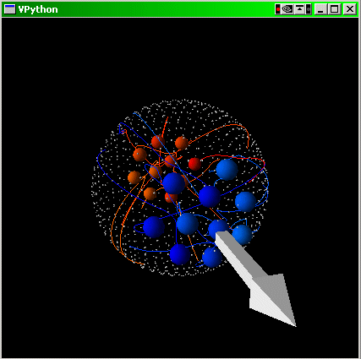
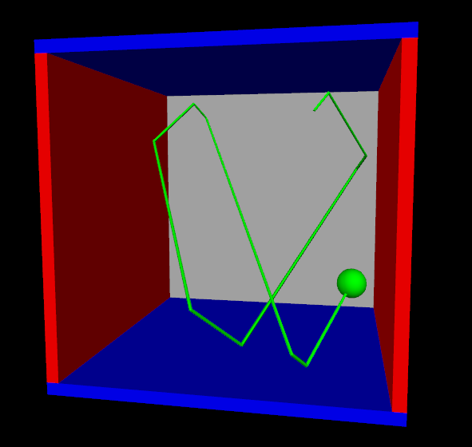
vPython을 활용한
visual simmulation
https://glowscript.org/

Slide 2
도움자료
예제 : https://www.glowscript.org/#/user/GlowScriptDemos/folder/Examples/
Tutorial :https://www.glowscript.org/docs/VPythonDocs/VPython_Intro.pdf
도움말 : https://www.glowscript.org/docs/VPythonDocs/index.html
vpython & 물리 :
https://www.youtube.com/watch?v=pzKJ_R-Ipho&list=PLO7G1xLUawYDrpr7bSk_c_XABpy-Ohatc&index=55
https://www.youtube.com/watch?v=FyEWafwMJf8&list=PLO7G1xLUawYDrpr7bSk_c_XABpy-Ohatc&index=56
https://www.youtube.com/watch?v=RdXXdkQ4foE&list=PLO7G1xLUawYDrpr7bSk_c_XABpy-Ohatc&index=57

Slide 3
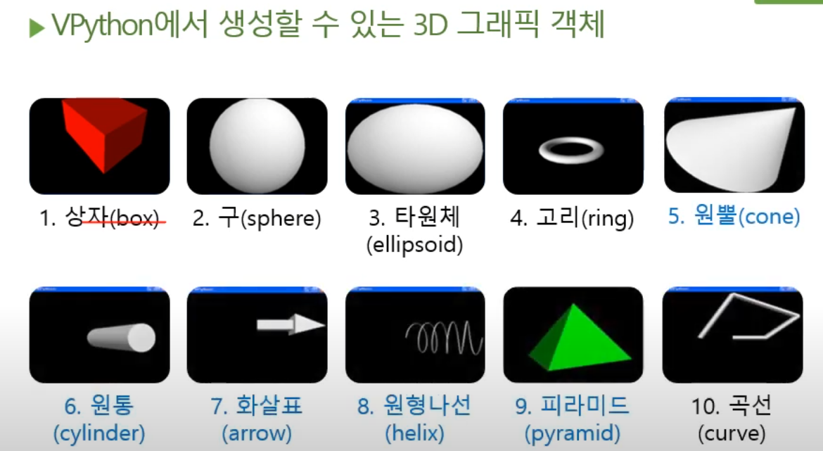
vPython의 3차원 객체
상자를 그리고 싶다면?
box() # 기본형
box(pos=위치, color=색상, radius=크기)
구를 그리고 싶다면?
sphere() # 기본형
sphere(pos=위치, color=색상, radius=크기)
스피링을 그리고 싶다면?
helix() # 기본형
helix(위치, 색상, 크기)

Slide 4
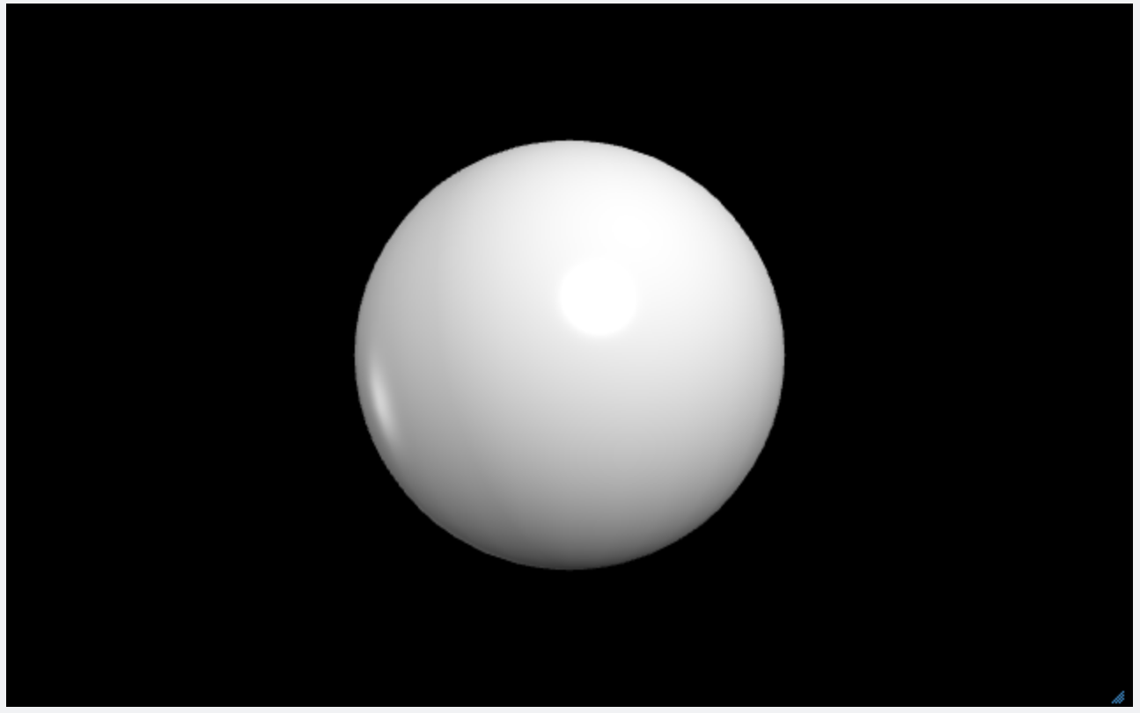
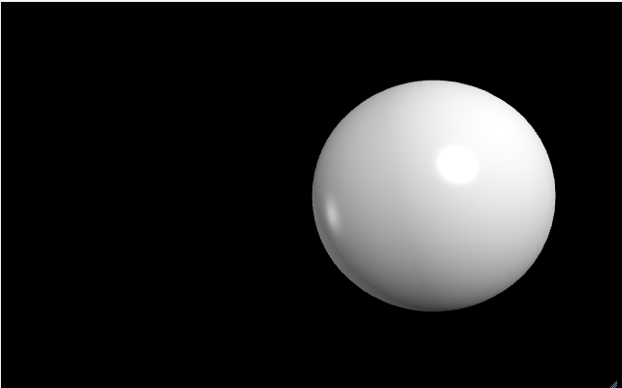
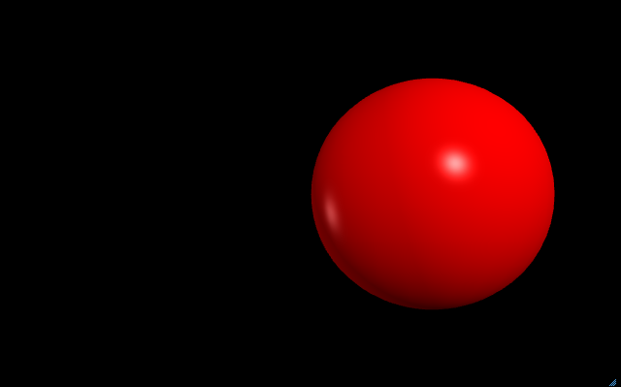
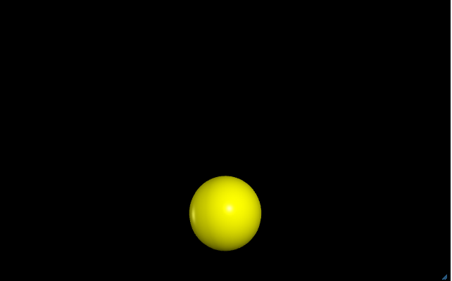
객체
객체 = 변수(값, 속성) + 함수(메서드)
위치변수 pos
pos = 벡터값 # 기본값 : vector(0, 0, 0)
색상변수 color
color = 벡터값 # 기본값 : vector(1, 1, 1)
크기변수 radius
radius = 스칼라 # 기본값 : 2
… 나머지 변수와 기본값은 도움말 링크 참조
https://www.glowscript.org/docs/VPythonDocs/sphere.html
(x, y, z)
sphere(pos=vector(0, 0, 0), color=vector(1, 1, 1), radius=2)
혹은
sphere()
원점
속성(=변수값)
pos : vector(0, 0, 0)
color : vector(1, 1, 1)
radius : 2
(R, G, B)
흰색
sphere(pos=vector(1, 0, 0))
sphere(pos=vector(1, 0, 0), color=(1, 0, 0))
sphere(pos=vector(0, 1, 0), color=(1, 1, 0), radius=0.5))
속성(=변수값)
pos : vector(1, 0, 0)
color : vector(1, 1, 1)
radius : 2
속성(=변수값)
pos : vector(1, 0, 0)
color : vector(1, 0, 0)
radius : 2
속성(=변수값)
pos : vector(0, 1, 0)
color : vector(1, 1, 0)
radius : 0.5

Slide 5
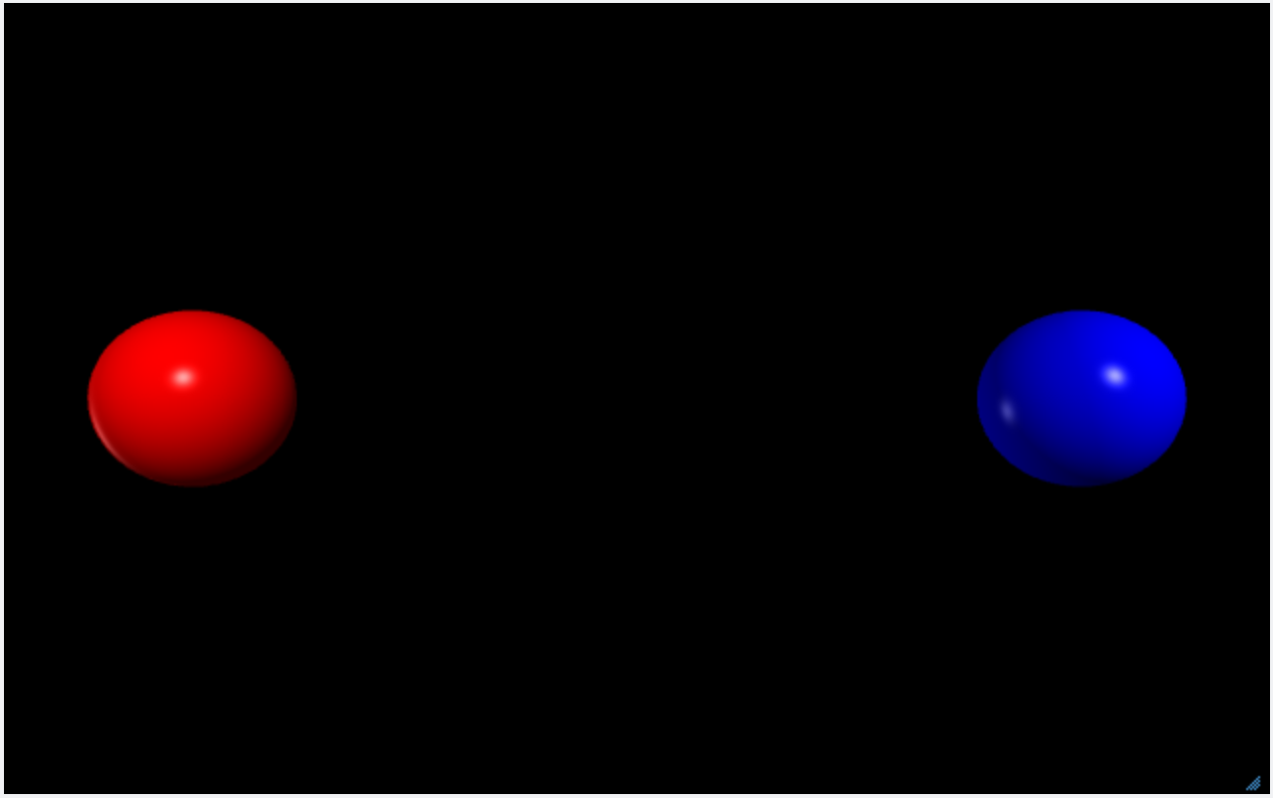
객체를 변수에 할당해 보자…
두 개의 구 객체를 생성하기
pos = vector(-5, 0, 0)
color = vector(1, 0, 0)
radius = 1
Web VPython 3.2
sphere(pos=vector(-5,0,0), color=vector(1,0,0), radius=1)
sphere(pos=vector(5,0,0), color=vector(0,0,1), radius=1)
pos = vector(5, 0, 0)
color = vector(0, 0, 1)
radius = 1
구 객체를 lball, rball 변수에 할당
lball.pos = vector(-5, 0, 0)
lball.color = vector(1, 0, 0)
lball.radius = 1
Web VPython 3.2
lball = sphere(pos=vector(-5,0,0), color=vector(1,0,0), radius=1)
rball = sphere(pos=vector(5,0,0), color=vector(0,0,1), radius=1)
rball
lball
rball.pos = vector(5, 0, 0)
rball.color = vector(0, 0, 1)
rball.radius = 1

Slide 6
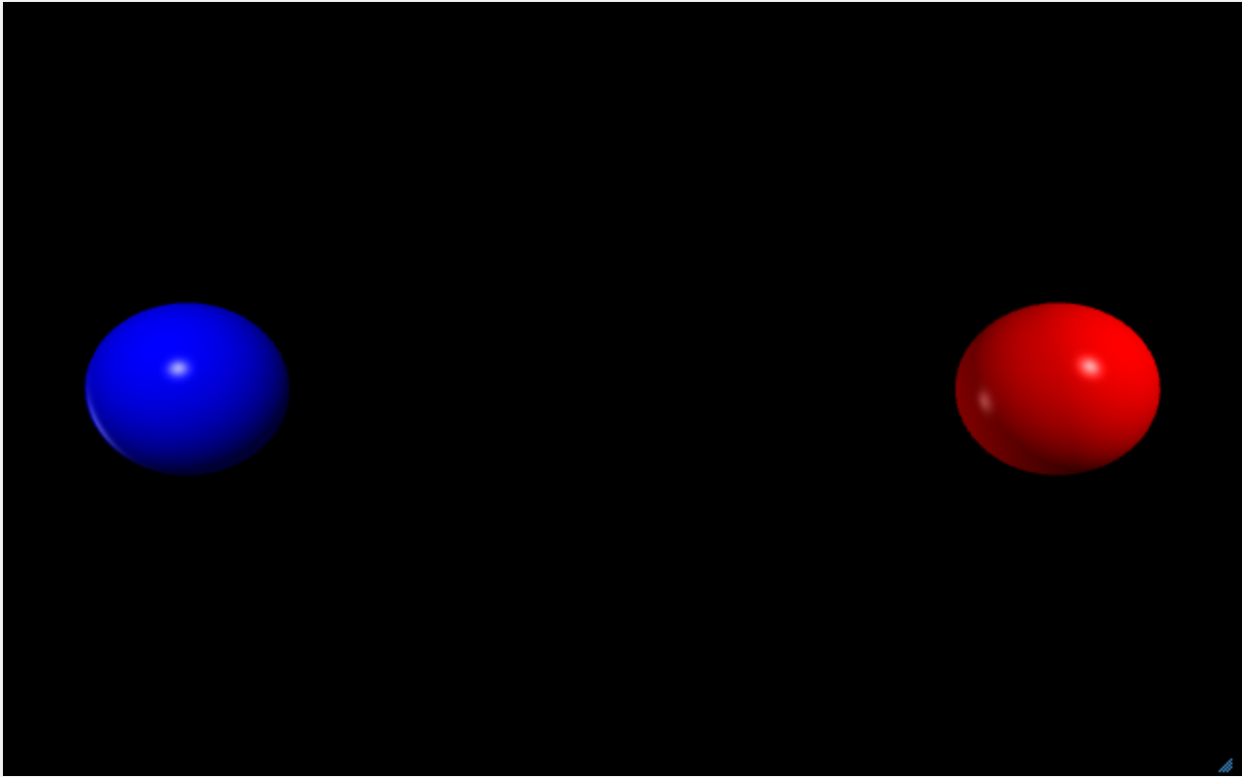
기존 구 객체의 색상이나 위치를 변경해 보기
lball.pos = vector(-5, 0, 0)
lball.color = vector(1, 0, 0)
lball.radius = 1
구 객체를 lball, rball 변수에 할당
Web VPython 3.2
lball = sphere(pos=vector(-5,0,0), color=vector(1,0,0), radius=1)
rball = sphere(pos=vector(5,0,0), color=vector(0,0,1), radius=1)
rate(0.5) # 0.5초 지연이 아님, (1/0.5)초 지연
lball.color = vector(0, 0, 1)
rball.color = vector(1, 0, 0)
rball
lball
rball.pos = vector(5, 0, 0)
rball.color = vector(0, 0, 1)
rball.radius = 1
lball.pos = vector(-5, 0, 0)
lball.color = vector(0, 0, 1)
lball.radius = 1
rball
lball
rball.pos = vector(5, 0, 0)
rball.color = vector(1, 0, 0)
rball.radius = 1

Slide 7
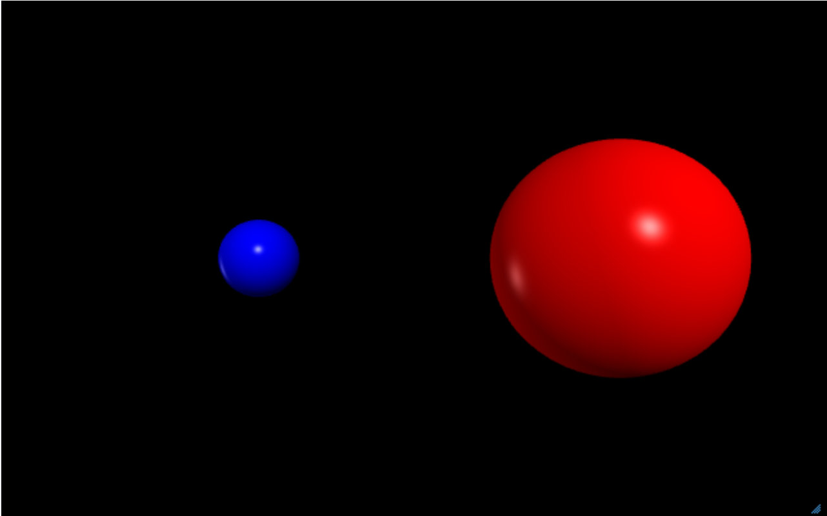
기존 구 객체의 색상을 변경해 보기
Web VPython 3.2
lball = sphere(pos=vector(-5,0,0), color=vector(1,0,0), radius=1)
rball = sphere(pos=vector(5,0,0), color=vector(0,0,1), radius=1)
rate(0.5) # 0.5초 지연이 아님, (1/0.5)초 지연
lball.color = vector(0, 0, 1)
rball.color = vector(1, 0, 0)
# 1초 지연 ??
# lball으로 오른쪽으로 1만큼 ??
# rball의 radius를 3으로
2초후
파랑색으로
빨강색으로
1초후
오른쪽으로 1만큼
이동
radius를
3으로

Slide 8
객체에 새로운 변수 추가
Web VPython 3.2
lball = sphere(pos=vector(-5,0,0), color=vector(1,0,0), radius=1)
rball = sphere(pos=vector(5,0,0), color=vector(0,0,1), radius=1)
# 객체에 새로운 변수 추가
lball.cnsh = "충남과학고등학교" # cnsh라는 변수 추가
rball.mass = 1.0 # 질량 변수 추가
rball.velocity = vector(1, 0, 0) # 속도 변수 추가
print(lball.cnsh)
print(rball.velocity)
lball.pos = vector(-5, 0, 0)
lball.color = vector(1, 0, 0)
lball.radius = 1
# cnsh라는 변수가 추가
lball.cnsh = "충남과학고등학교"
파랑색으로
빨강색으로
radius를
3으로
rball.pos = vector(5, 0, 0)
rball.color = vector(0, 0, 1)
rball.radius = 1
# 새로운 변수 추가
rball.mass = 1.0
rball.velocity = vector(1, 0, 0)
오른쪽으로 1만큼
이동

Slide 10
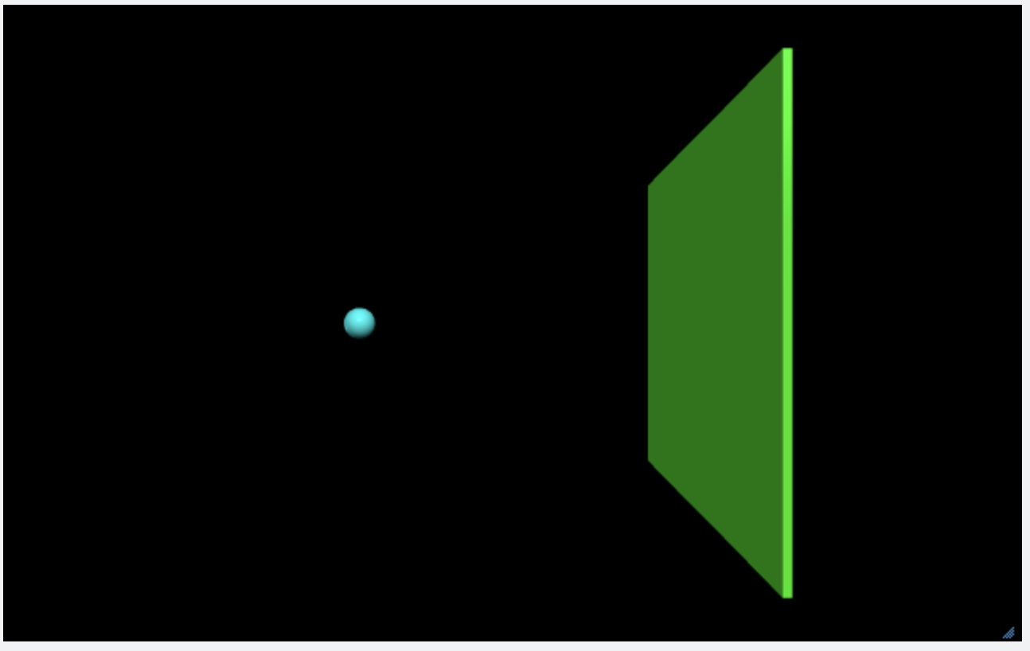
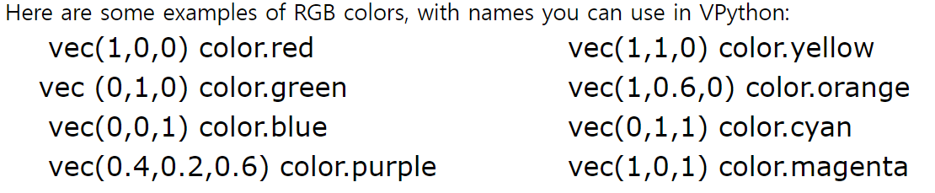
공간 만들기
Web VPython 3.2
ball = sphere(pos=vector(-5,0,0), radius=0.5, color=color.cyan)
wallR = box(pos=vector(6,0,0), size=vector(0.2,12,12), color=color.green)
참고 : 사전 정의된 색상이 있음
https://www.glowscript.org/docs/VPythonDocs/color.html

Slide 11
ball에 속도 변수 추가
Web VPython 3.2
ball = sphere(pos=vector(-5,0,0), radius=0.5, color=color.cyan)
wallR = box(pos=vector(6,0,0), size=vector(0.2,12,12), color=color.green)
t = 0
delta_t = 0.005
ball.velocity = vector(25,0,0) # ball에 속도를 저장할 velocity 변수 추가
ball.pos = ball.pos + ball.velocity * delta_t # ball의 처음 위치 + (delta_t초 동안 움직인 거리)
# <-5, 0, 0> + <25, 0, 0> * 0.005
<-5, 0, 0> + <25, 0, 0> * 0.005
= <-5, 0, 0> + <25*0.005, 0*0.005, 0*0.005>
= <-5, 0, 0> + <0.125, 0, 0>
= <-4.875, 0, 0>
ball.pos = vector(-5, 0, 0)
ball.radius = 0.5
ball.color = vector(0, 1, 1)
# 속도 변수 velocity 추가
ball.velocity = vector(25, 0, 0)

Slide 12
벡터 객체와 스칼라 값의 연산 예시
vector(1, 2, 3) + vector(2, 0, 0)
= vector(3, 2, 3)
vector(1, 2, 3) - vector(2, 2, 2)
= vector(-1, 0, 1)
vector(1, 2, 3) * 2
= vector(2, 4, 6)
vector(1, 2, 3) / 2
= vector(0.5, 1, 1.5)

Slide 13
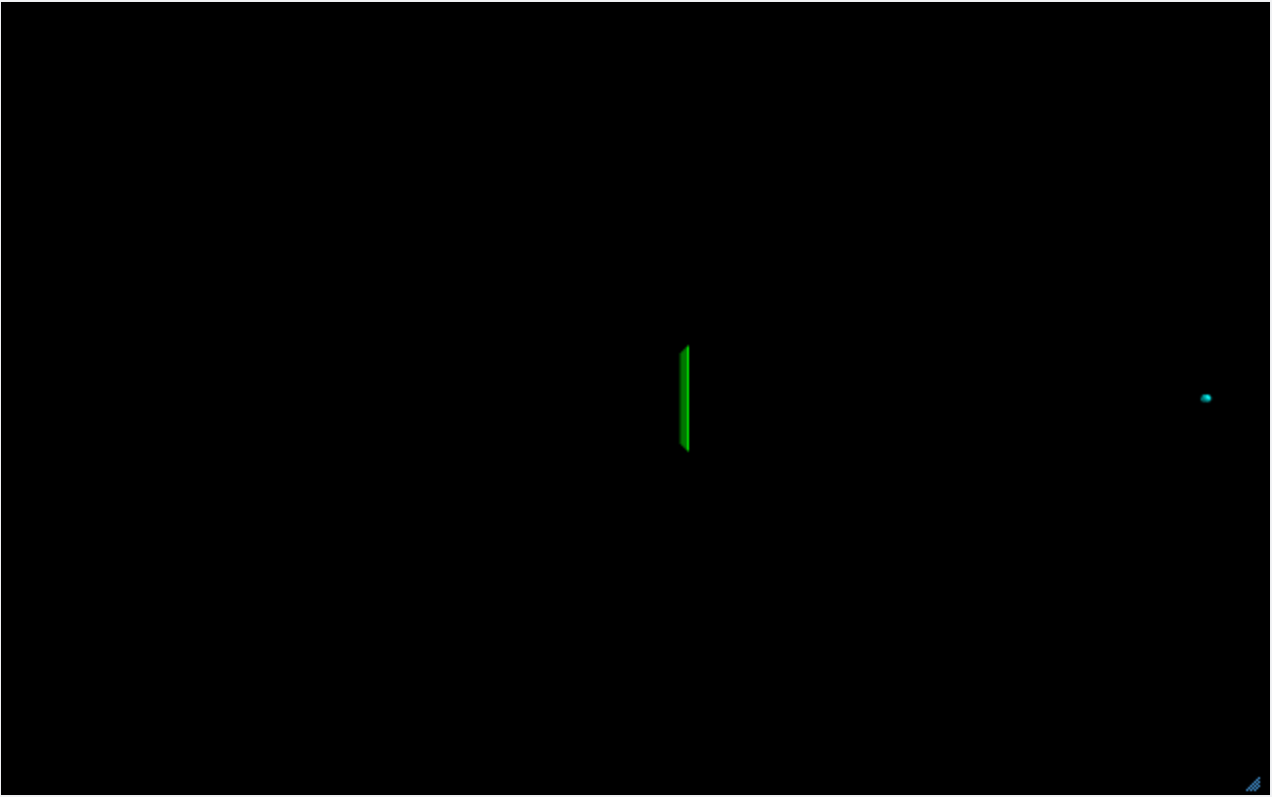
ball을 연속적으로 움직이기
Web VPython 3.2
ball = sphere(pos=vector(-5,0,0), radius=0.5, color=color.cyan)
wallR = box(pos=vector(6,0,0), size=vector(0.2,12,12), color=color.green)
t = 0
delta_t = 0.005
ball.velocity = vector(25,0,0)
while t <= 3:
ball.pos = ball.pos + ball.velocity * delta_t
t = t + deltat
# 최초
(-5, 0, 0) + (25, 0, 0) * 0.005
= (-5, 0, 0) + (25*0.005, 0*0.005, 0*0.005)
= (-5, 0, 0) + (0.125, 0, 0)
= (-4.875, 0, 0)
한방에…(이게 아닌데???)

Slide 14
ball을 연속적으로 움직이기
Web VPython 3.2
ball = sphere(pos=vector(-5,0,0), radius=0.5, color=color.cyan)
wallR = box(pos=vector(6,0,0), size=vector(0.2,12,12), color=color.green)
t = 0
delta_t = 0.005
ball.velocity = vector(25,0,0)
while t <= 3:
rate(100) # 1/100 sec초 지연
ball.pos = ball.pos + ball.velocity * delta_t
t = t + delta_t
t(시간) ball.pos(공의 위치)
--------------------
0.000 <-5, 0, 0> 최초
0.005 <-4.875, 0, 0>
0.010 <-4.75, 0, 0>
0.015 <-4.625, 0, 0>
……
2.985 <69.625, 0, 0>
2.990 <69.75, 0, 0>
2.995 <69.875, 0, 0>
3.000 <70, 0, 0 > 마지막
1/100초에 한번씩 움직이도록…

Slide 15
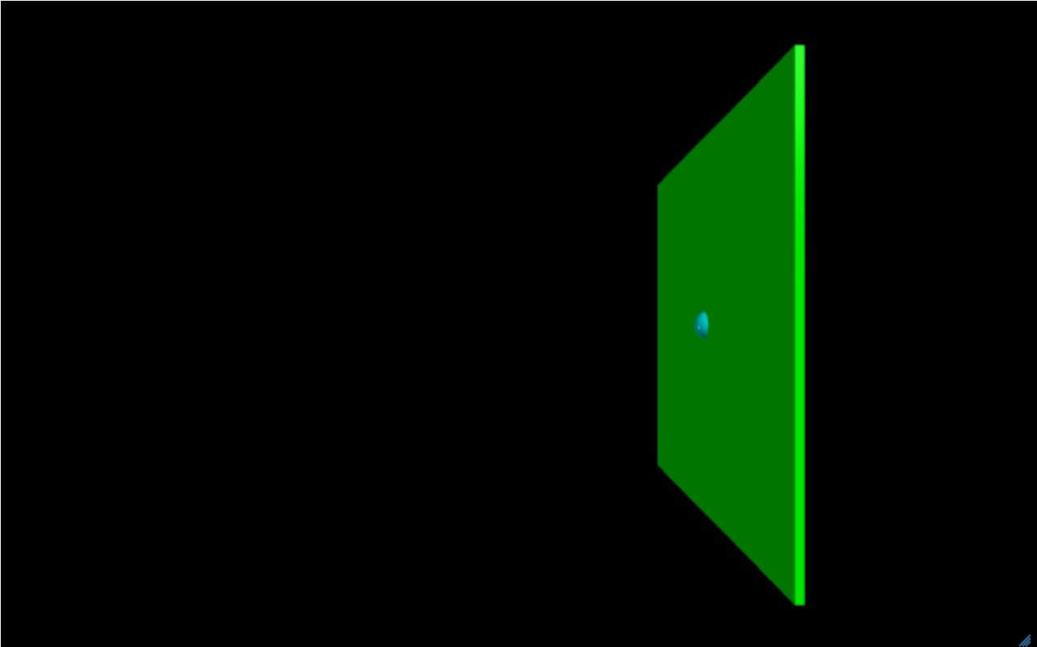
ball이 WallR에 부딪히면 튀어나오기
Web Vpython 3.2
ball = sphere(pos=vector(-5,0,0), radius=0.5, color=color.cyan)
wallR = box(pos=vector(6,0,0), size=vector(0.2,12,12), color=color.green)
t = 0
delta_t = 0.005
ball.velocity = vector(25,0,0)
while t <= 3:
rate(100)
if ball.pos.x > wallR.pos.x :
ball.velocity.x = -ball.velocity.x
ball.pos = ball.pos + ball.velocity * delta_t
t = t + delta_t
t(시간) ball.pos(공의 위치)
--------------------
0.000 <-5, 0, 0> 최초
0.005 <-4.875, 0, 0>
0.010 <-4.75, 0, 0>
0.015 <-4.625, 0, 0>
…
0.430 <5.750, 0, 0 >
0.435 <5.875, 0, 0 >
0.440 <6.000, 0, 0 >
0.445 <6.125, 0, 0 >
만약 ball.pos.x > wallR.pos.x 라면
<?, 0, 0> <6, 0, 0>
ball.velocity = <25, 0, 0> * -1
= <-25, 0, 0>

Slide 16
왼쪽 벽 추가 및 왼쪽 벽에 부딪히면 튀어나오기
Web VPython 3.2
ball = sphere(pos=vector(-5,0,0), radius=0.5, color=color.cyan)
wallR = box(pos=vector(6,0,0), size=vector(0.2,12,12), color=color.green)
wallL = box(pos=vector(-6,0,0), size=vector(0.2,12,12), color=color.green)
ball.velocity = vector(25,0,0)
deltat = 0.005
t = 0
while t <= 3:
rate(100)
if ball.pos.x > wallR.pos.x:
ball.velocity.x = -ball.velocity.x
if ball.pos.x < wallL.pos.x:
ball.velocity.x = -ball.velocity.x
ball.pos = ball.pos + ball.velocity*deltat
t = t + deltat

Slide 17
왼쪽 벽 추가 및 왼쪽 벽에 부딪히면 튀어나오기
Web VPython 3.2
ball = sphere(pos=vector(-5,0,0), radius=0.5, color=color.cyan)
wallR = box(pos=vector(6,0,0), size=vector(0.2,12,12), color=color.green)
wallL = box(pos=vector(-6,0,0), size=vector(0.2,12,12), color=color.green)
ball.velocity = vector(25,0,0)
deltat = 0.005
t = 0
while t <= 3:
rate(100)
if ball.pos.x > wallR.pos.x:
ball.velocity.x = -ball.velocity.x
if ball.pos.x < wallL.pos.x:
ball.velocity.x = -ball.velocity.x
ball.pos = ball.pos + ball.velocity*deltat
t = t + deltat
if ball.pos.x > wallR.pos.x or ball.pos.x < wallL.pos.x:
ball.velocity.x = -ball.velocity.x

Slide 18
공의 궤적 자취 남기기
Web VPython 3.2
ball = sphere(pos=vector(-5,0,0), radius=0.5, color=color.cyan, make_trail=True, retain=30)
wallR = box(pos=vector(6,0,0), size=vector(0.2,12,12), color=color.green)
wallL = box(pos=vector(-6,0,0), size=vector(0.2,12,12), color=color.green)
ball.velocity = vector(25,0,0)
deltat = 0.005
t = 0
while t <= 3:
rate(100)
if ball.pos.x > wallR.pos.x or ball.pos.x < wallL.pos.x:
ball.velocity.x = -ball.velocity.x
ball.pos = ball.pos + ball.velocity*deltat
t = t + deltat

Slide 19
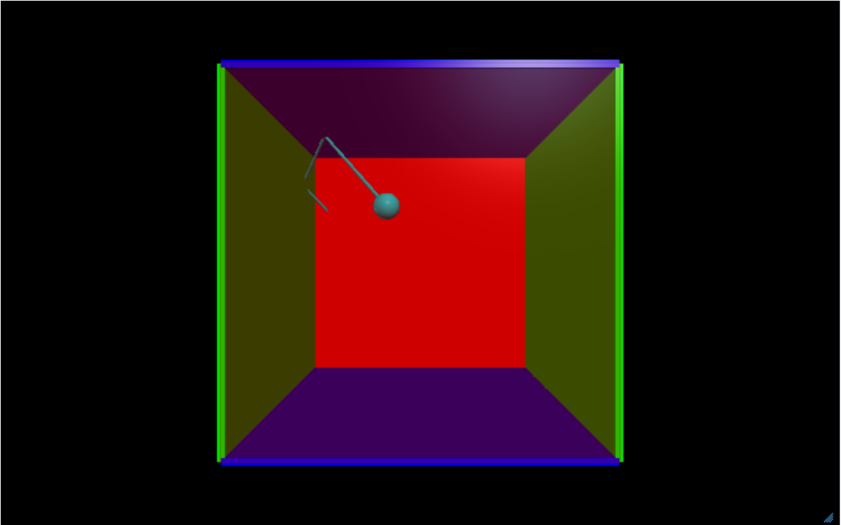
모든 벽 추가하기
Web VPython 3.2
ball = sphere(pos=vector(-5,0,0), radius=0.5, color=color.cyan, make_trail=True, retain=30)
wallR = box(pos=vector(6,0,0), size=vector(0.2,12,12), color=color.green)
wallL = box(pos=vector(-6,0,0), size=vector(0.2,12,12), color=color.green)
wallT = box(pos=vector(0,6,0), size=vector(12,0.2,12), color=color.blue)
wallB = box(pos=vector(0,-6,0), size=vector(12,0.2,12), color=color.blue)
wallF = box(pos=vector(0,0,6), size=vector(12,12,0.2), color=color.red, opacity=0.2)
wallRE = box(pos=vector(0,0,-6), size=vector(12,12,0.2), color=color.red)
#ball.velocity = vector(25, 0, 0)
ball.velocity = vector(25, 30, -35)
delta_t = 0.005
t = 0
while True:
rate(100)
if ball.pos.x > wallR.pos.x or ball.pos.x < wallL.pos.x:
ball.velocity.x = -ball.velocity.x
if ball.pos.y > wallT.pos.y or ball.pos.y < wallB.pos.y:
ball.velocity.y = -ball.velocity.y
if ball.pos.z > wallF.pos.z or ball.pos.z < wallRE.pos.z:
ball.velocity.z = -ball.velocity.z
ball.pos = ball.pos + ball.velocity*delta_t
t = t + delta_t

Slide 20
탑재된 코드
Web VPython 3.2
side = 4.0
thk = 0.3
s2 = 2*side - thk
s3 = 2*side + thk
wallR = box (pos=vector( side, 0, 0), size=vector(thk, s2, s3), color = color.red)
wallL = box (pos=vector(-side, 0, 0), size=vector(thk, s2, s3), color = color.red)
wallB = box (pos=vector(0, -side, 0), size=vector(s3, thk, s3), color = color.blue)
wallT = box (pos=vector(0, side, 0), size=vector(s3, thk, s3), color = color.blue)
wallBK = box(pos=vector(0, 0, -side), size=vector(s2, s2, thk), color = color.gray(0.7))
ball = sphere (color = color.green, radius = 0.4, make_trail=True, retain=200)
ball.mass = 1.0
ball.p = vector (-0.15, -0.23, +0.27)
side = side - thk*0.5 - ball.radius
dt = 0.3
def move():
rate(200, move)
ball.pos = ball.pos + (ball.p/ball.mass)*dt
if not (side > ball.pos.x > -side):
ball.p.x = -ball.p.x
if not (side > ball.pos.y > -side):
ball.p.y = -ball.p.y
if not (side > ball.pos.z > -side):
ball.p.z = -ball.p.z
move()

Slide 21
그래프 그리기

Slide 22
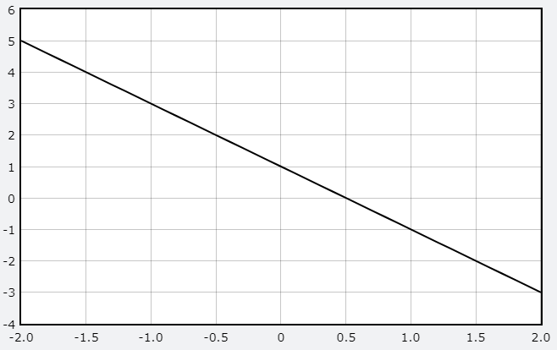
그래프 그리기
Web VPython 3.2
g = gcurve()
for x in arange(-2.0, 2.1, 0.1):
g.plot(pos=(x, -2*x+1))

Slide 23
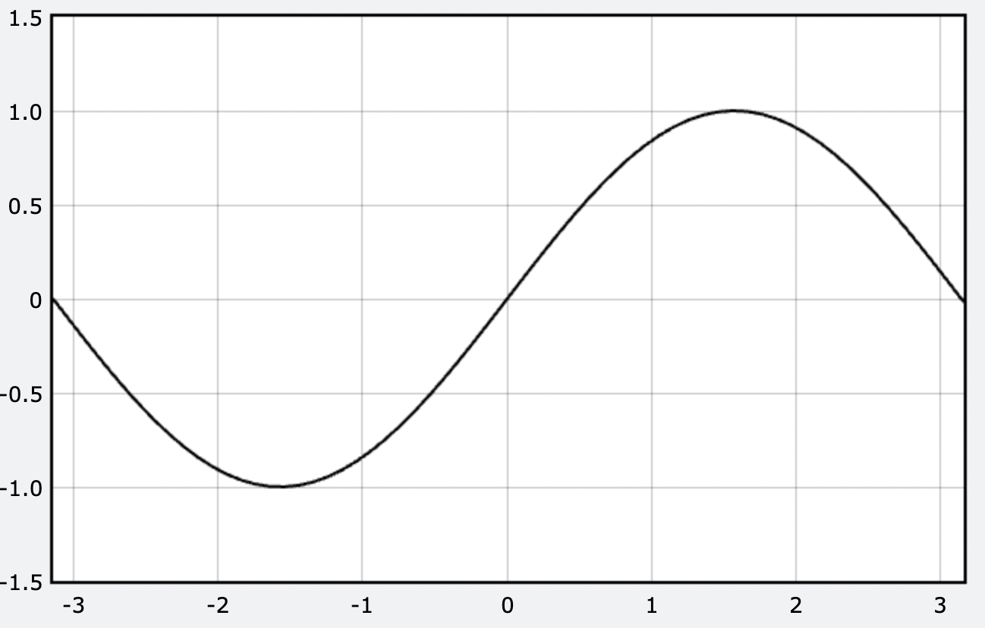
Web VPython 3.2
g = gcurve()
for x in arange(-pi, pi+0.1, 0.1):
g.plot(pos=(x, sin(x)))

Slide 24
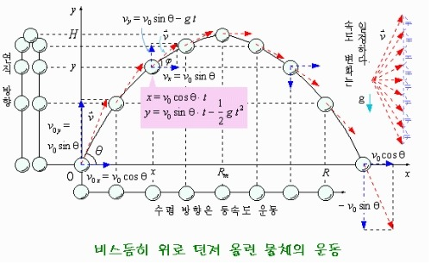

Slide 25
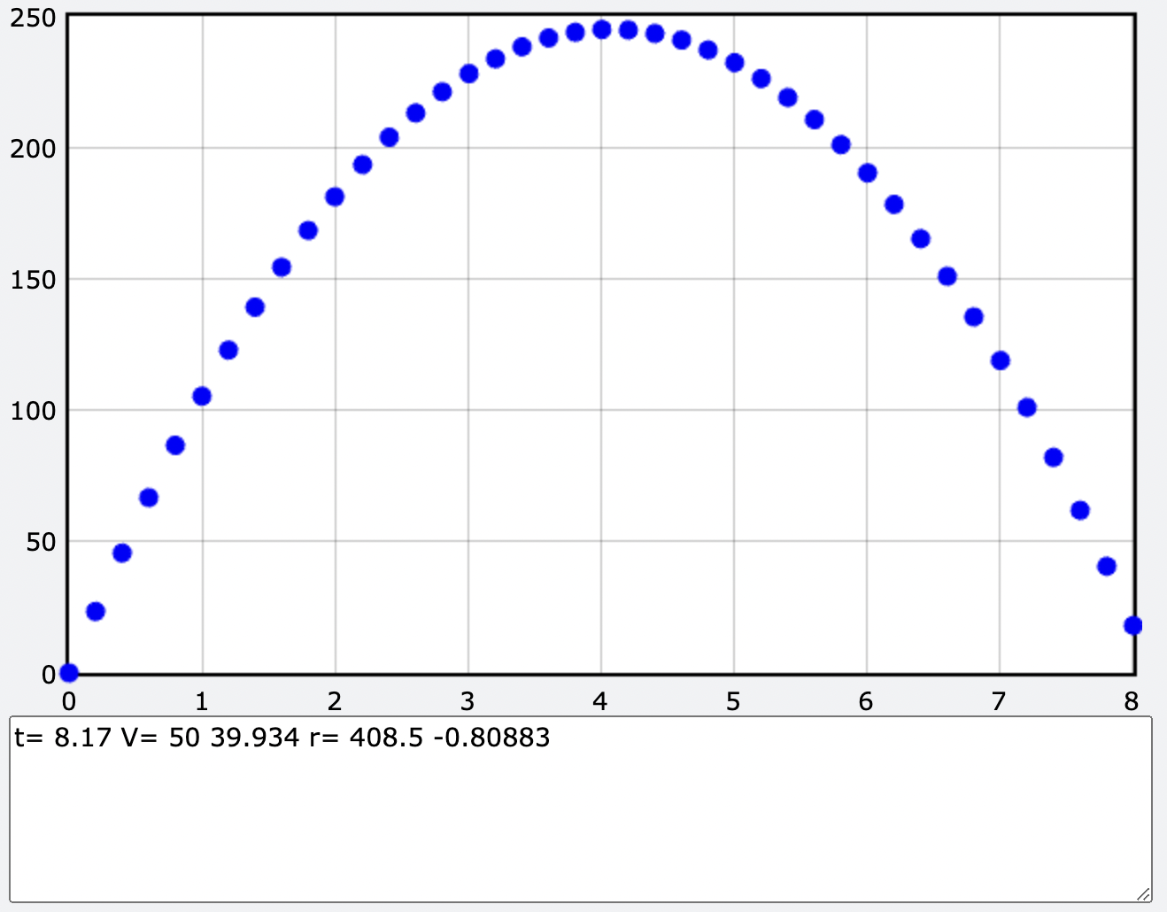
Web VPython 3.2
m = 0.1 # Kg
g = vector(0,-9.8,0) # m/s^2; 중력가속도
r0 = vector(0,0,0) # m
v0 = vector(50,120,0) # m/s
h = gdots(color=color.blue, size=10)
dt = 0.01
for t in arange(0, 10+dt, dt):
v = v0 + g * t
r = r0 + v * t + (g/2) * t ** 2
rate(1/dt)
if r.y >= 0:
if(int(t/dt) % 20 == 0):
h.plot(pos=(t,r.y))
if r.y<0:
print("t=",t , "V=", v.x, v.y, "r=", r.x, r.y)
break

Slide 26
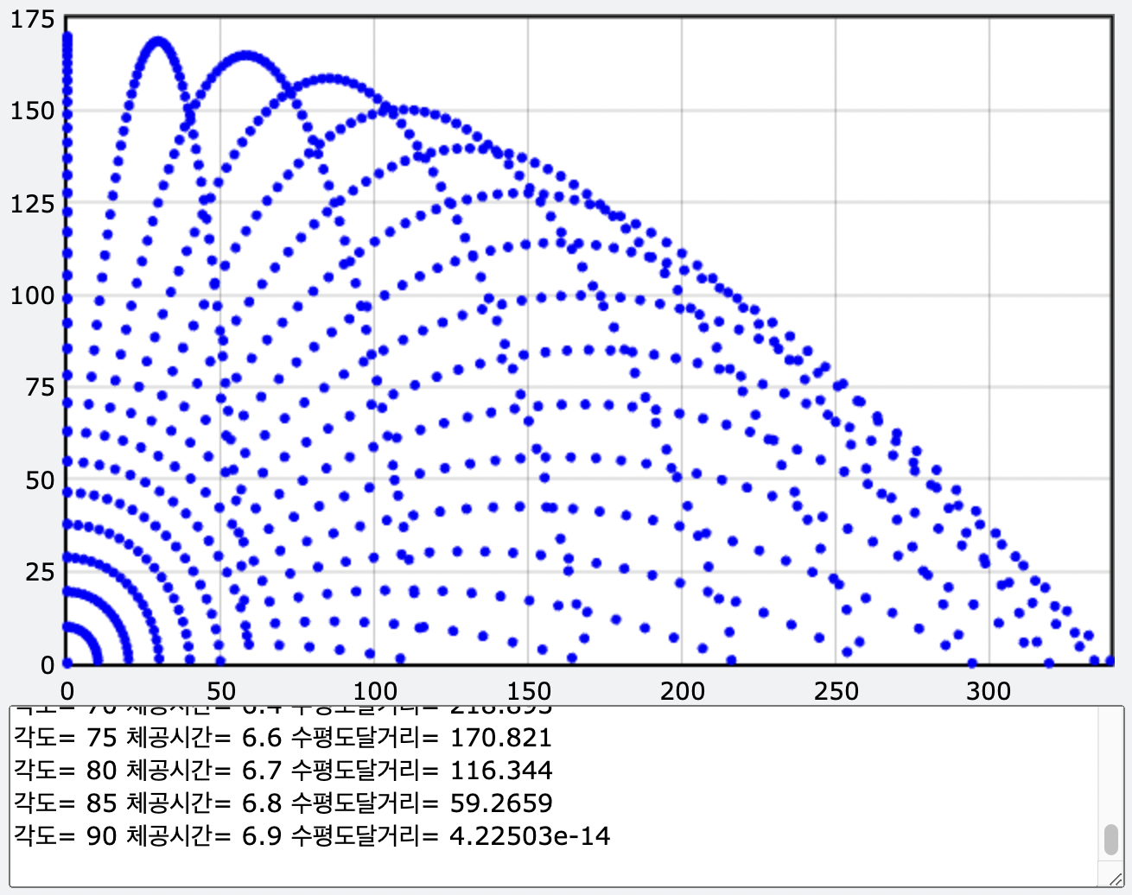
Web VPython 3.2
g=vector(0,-9.8,0) # m/s^2
vm=100 # m/s
r0=vector(0,0,0)
h=gdots(color=color.blue, size=5)
for angle in arange(0, 90+5, 5):
theta=angle*pi/180. #radian
v0=vector(vm*cos(theta), vm*sin(theta), 0)
for t in arange(0, 16, 0.1):
rate(50)
v=v0+g*t
r=r0+v*t+(g/2)*t**2
if r.y>=0:
h.plot(pos=(r.x, r.y))
elif r.y<=0:
print("각도=", angle, "체공시간=", t, "수평도달거리=", r.x)
break

